Slide 1
Exploring Cells and Organelles

Slide 2
Cells are the building blocks of all living things
You may already know that cells are the building blocks of all living things, but have you ever wondered what makes up a cell and how it functions? Let's delve into the microscopic realm of biology to discover more about organelles and why they are so important.

Slide 3
Organelles are specialised structures that work together to keep the cell alive and functioning correctly
Just like how different parts of a car work together to make it run smoothly, organelles have specific roles that contribute to the overall health of the cell.

Slide 4
Organelles help cells adapt to changes in their environment
Without organelles, cells would not be able to perform vital functions like growth, repair, and reproduction.

Slide 5
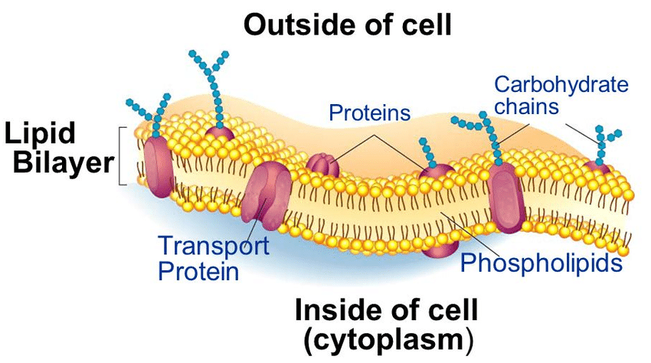
Cell Membrane
The cell membrane acts as the border patrol of the cell, controlling what goes in and out to maintain the cell's internal environment.

Slide 6
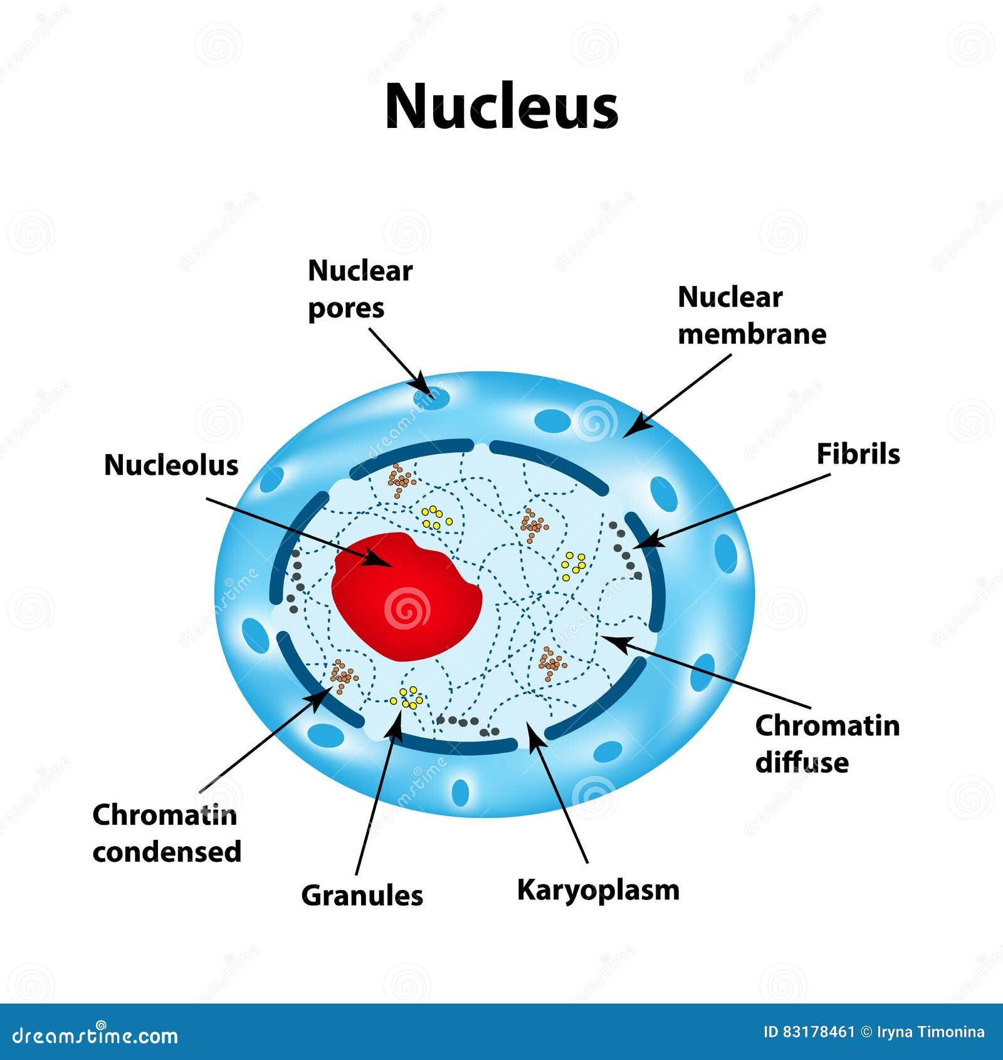
Nucleus
One of the most crucial organelles in a cell is the nucleus, often referred to as the "control center." The nucleus houses the genetic material (DNA) and directs the cell's activities.

Slide 7
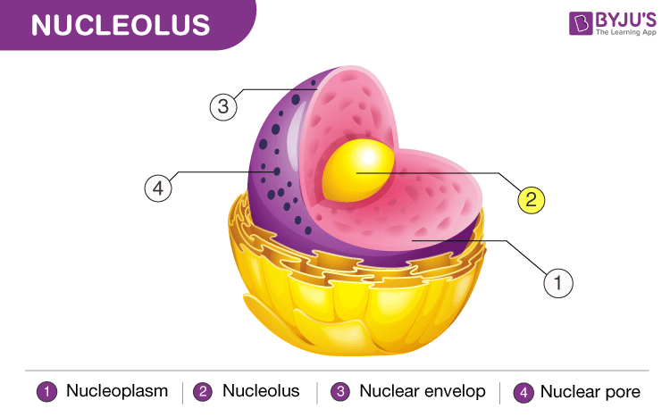
Nucleolus
Inside the nucleus, the nucleolus plays a key role in making ribosomes, the cell's protein factories.

Slide 8
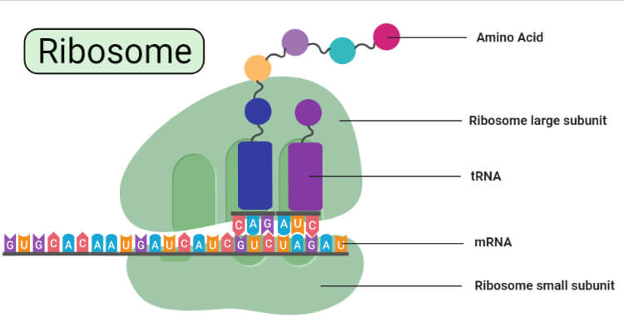
Ribosome
Ribosomes are where proteins are synthesised, following the instructions encoded in the DNA.

Slide 9
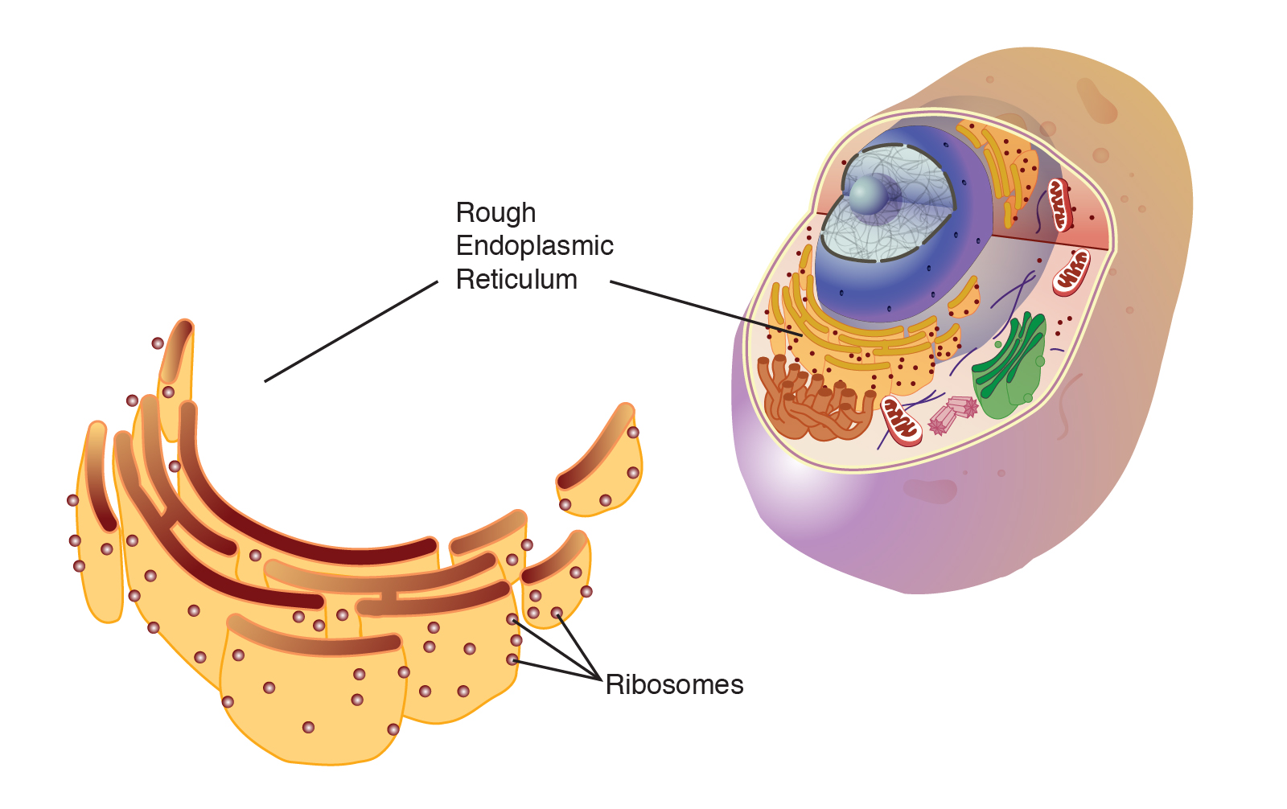
Rough Endoplasmic Reticulum (ER)
The rough ER has ribosomes attached to its surface and is involved in protein synthesis and transport

Slide 10
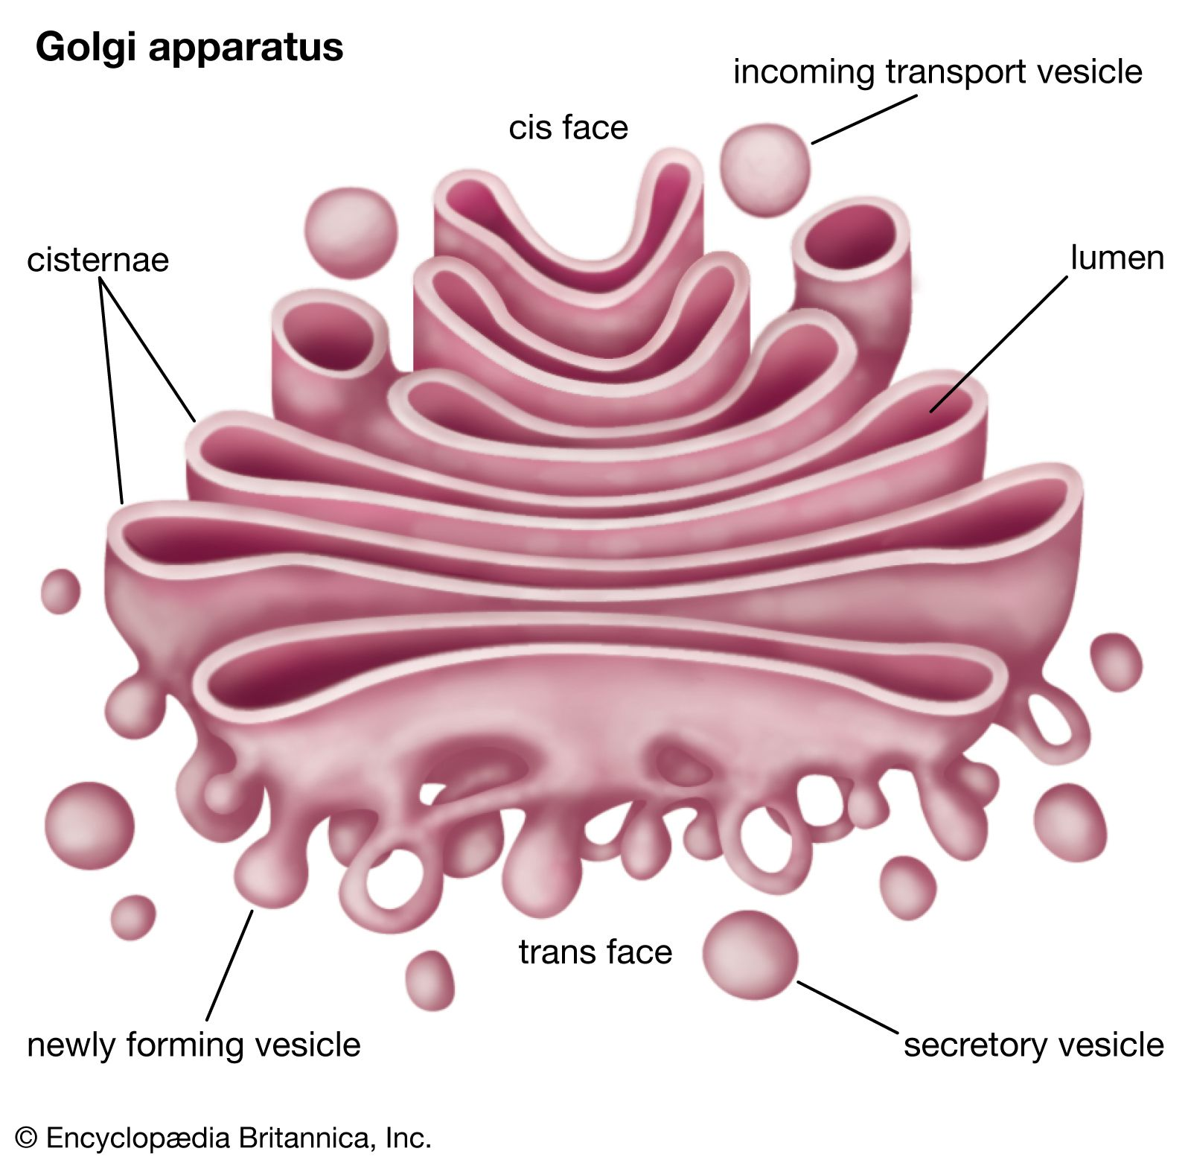
Golgi body
The Golgi body processes and packages proteins and lipids made by the cell for transport to their proper destinations.

Slide 11
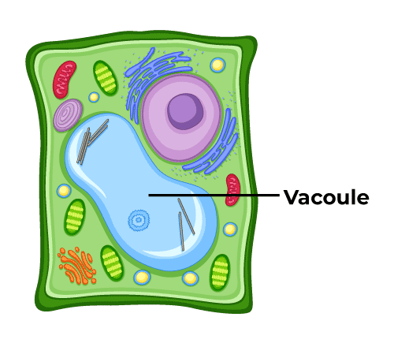
Vacuole
Vacuoles are storage sacs within the cell that can hold water, nutrients, or waste products, helping maintain the cell's shape and structure.

Slide 12
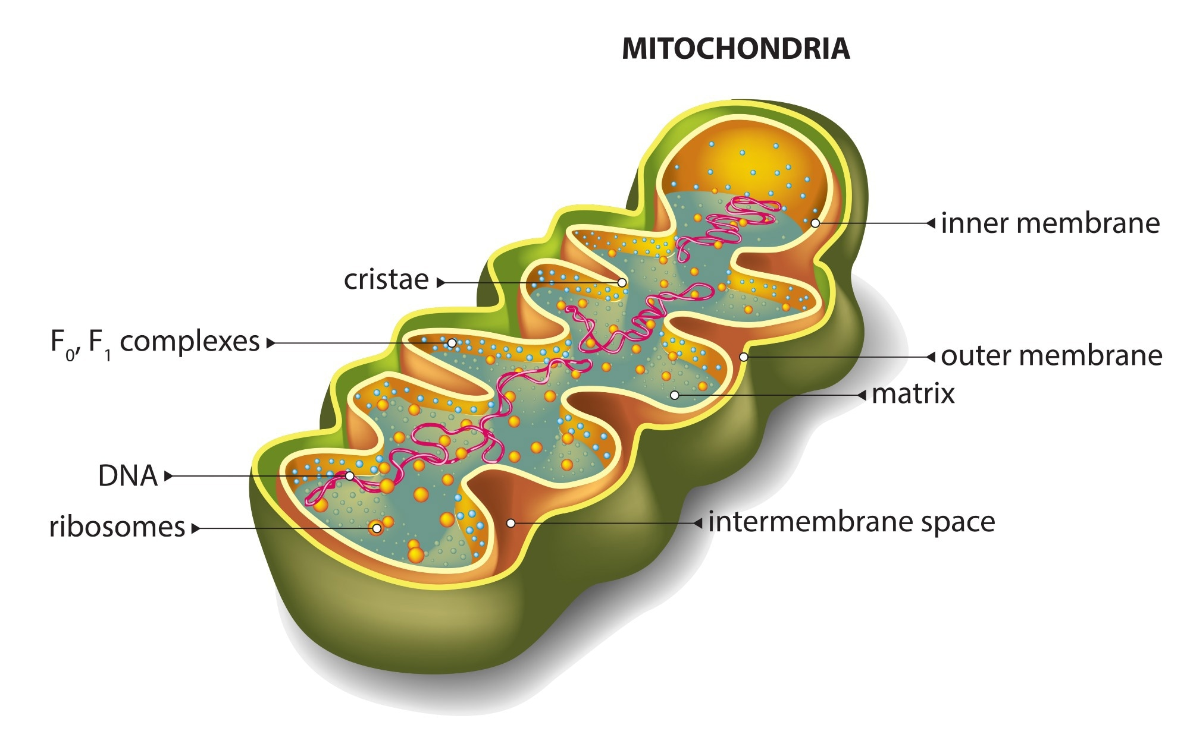
Mitochondria
The mitochondria produce energy (ATP) through cellular respiration, keeping the cell functioning.

Slide 13
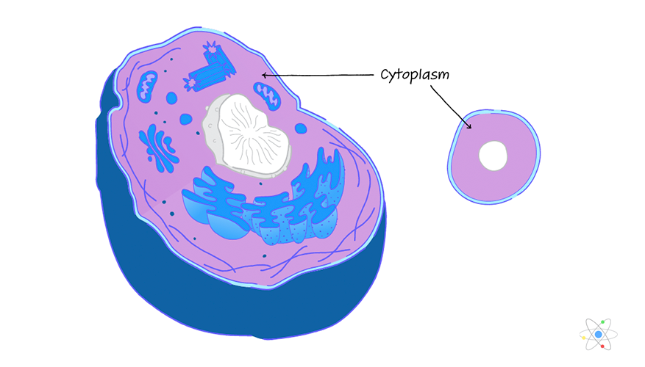
Cytoplasm
The jelly-like substance filling the cell, the cytoplasm supports the organelles and facilitates various cellular processes.

Slide 14
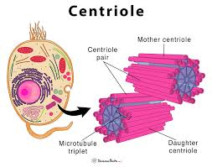
Centrioles
Centrioles are involved in cell division, helping to organize the microtubules to pull chromosomes apart during mitosis.

Slide 15
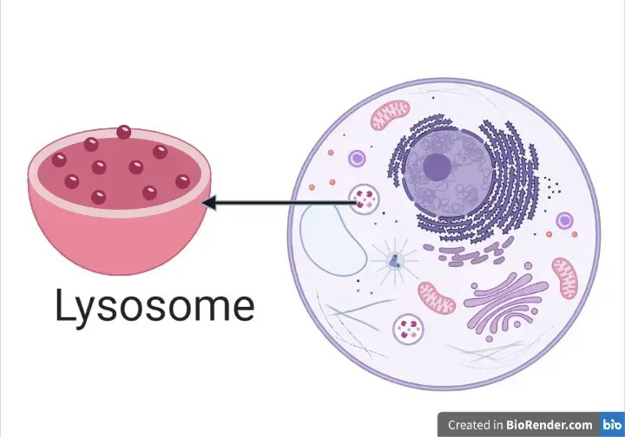
Lysosome
Lysosomes are like the cell's recycling centre, breaking down waste materials and helping to keep the cell clean and organised.

Slide 16
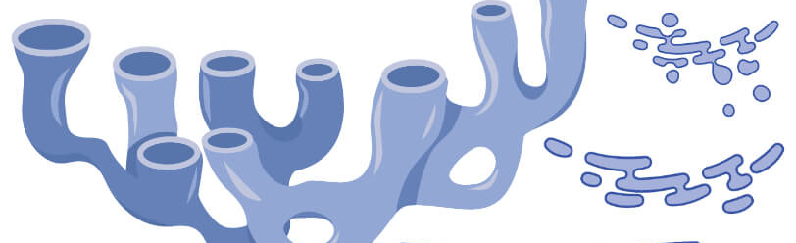
Smooth Endoplasmic Reticulum
The smooth ER is involved in fat metabolism and breaking down harmful substances in the cell.

Slide 17
Another essential organelle is the mitochondria, also known as the "powerhouse" of the cell. Just like how we need food for energy, the mitochondria produce energy for the cell through a process called cellular respiration. Without mitochondria, our cells wouldn't have the energy they need to carry out their functions.
In conclusion, organelles are like the dedicated workers in a busy factory, each with its own job to ensure the smooth operation of the cell. By working together harmoniously, these organelles enable cells to carry out complex functions essential for life. So the next time you look at a cell under a microscope, remember the intricate world of organelles that make it all possible.

